Slide 1
Worksheet
Primary 2

Slide 2
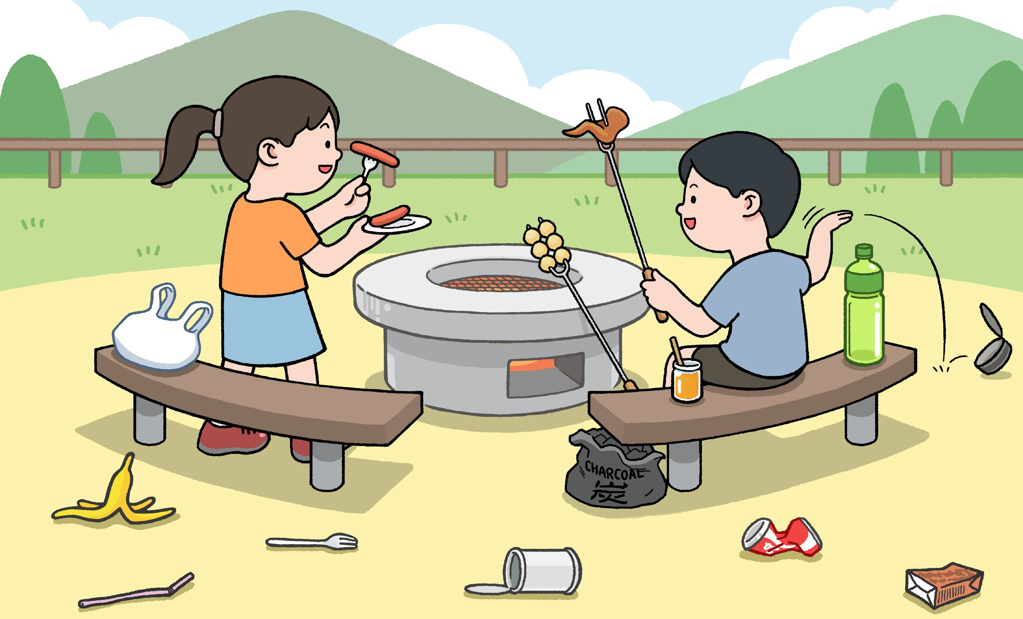
Enjoy Plastic-Free Countryside
Student Worksheet Name
Observe the behaviour of visitors and the waste they generate in the picture, in order to determine whether the waste will damage the natural environment. Please give a “ ✓ ” for behaviours that will damage the environment; otherwise, please give a “X” in the circles and circle the correct answer as appropriate.
Visitors (should / should not) leave any waste in the country park, such as tissues, plastic bottles, straws, etc.
The waste disposed in country park (will / will not) damage the ecological environment.
All visitors (need / do not need) to properly dispose of their own waste and (should / should not) establish a habit of “Take Your Litter Home”.

Slide 3
Drawing: List out and draw the plastic waste your family generated last weekend and record the amount of plastic waste generated.
Type of Plastic Waste (Examples):
Candy wrapper
Quantity
Type of Plastic Waste (Examples):
Quantity
1 ( piece )
( )
Picture (Example):
Picture:
Type of Plastic Waste (Examples):
Quantity
Type of Plastic Waste (Examples):
Quantity
( )
( )
Picture:
Picture:
Type of Plastic Waste (Examples):
Quantity
Type of Plastic Waste (Examples):
Quantity
( )
( )
Picture:
Picture:
According to the above record, the type of plastic waste my family frequently
generated is , we (can / cannot) reduce the wastage of resources through recycling.

Slide 4
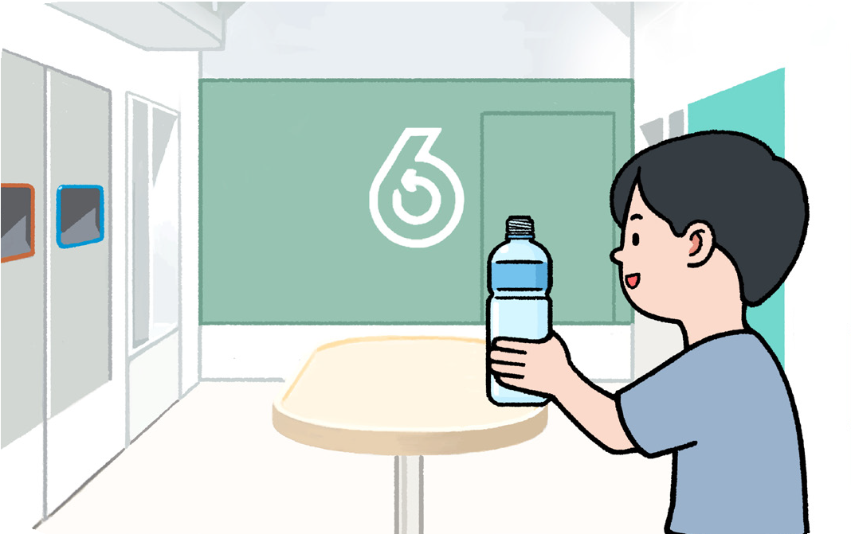
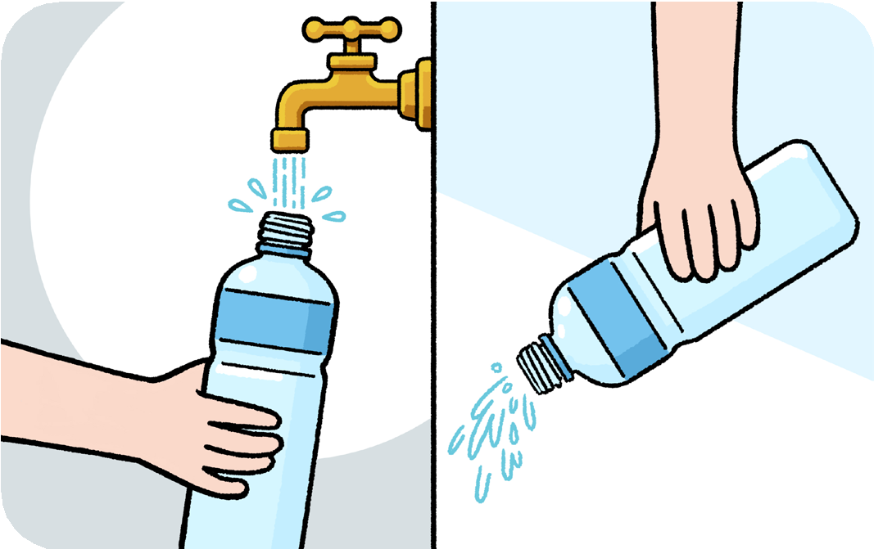
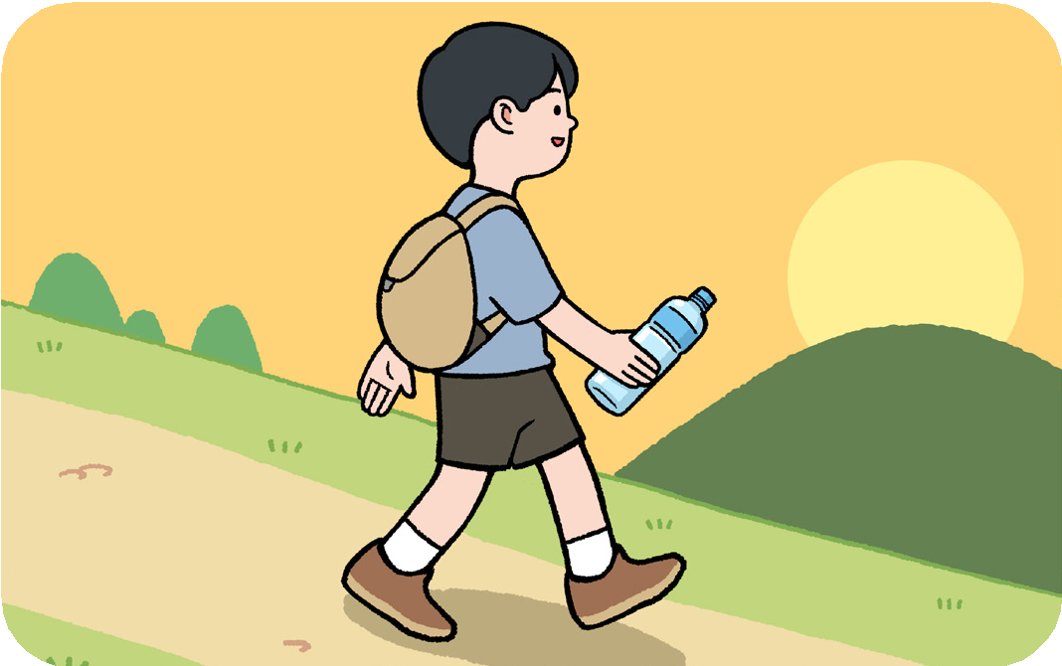
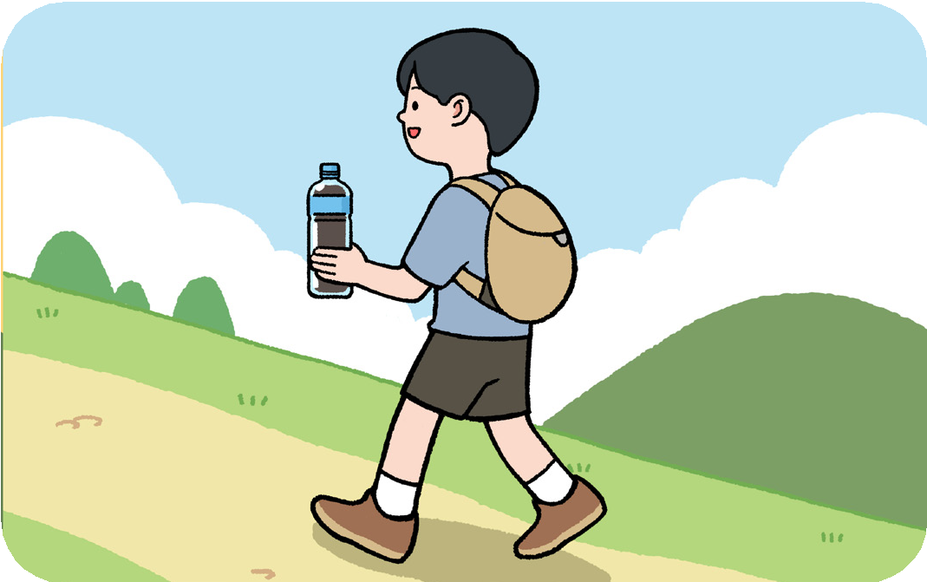
Sequencing: Arrange the answers in accordance to the sequence of events in the story, and write down a letter representing the correct answer in the circle.
Story Background: Ben went for a hike in a country park and generated plastic waste during hiking. How should he handle with the waste when he left?
Correct order:
What did Ben bring for hiking? (Please circle the correct answer)
Ben brought (a plastic bottle / a paper cup / an aluminium can) for hiking.
Following the above question, what is Ben required to do before recycling the recyclables?
As the item is recyclable, Ben should the recyclable item before recycling at “GREEN@COMMUNITY” .

